Slide 1
Not Netflix
movie database
Henry, John, Ben

Slide 2
Overview
Database to store information about movies
Movie objects
Title
Year
Genre
Rating
ID
Runtime
User can search with different keywords

Slide 3
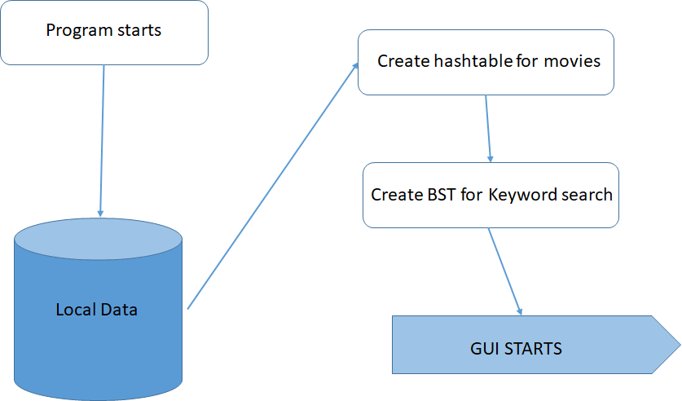
Program workflow

Slide 4
Menu operations
Search for a movie
View related movies
Add a new movie
Remove a movie
Edit a movie
Pick from potential matches
Undo a deletion
Exit program

Slide 5
Data Structures

Slide 6
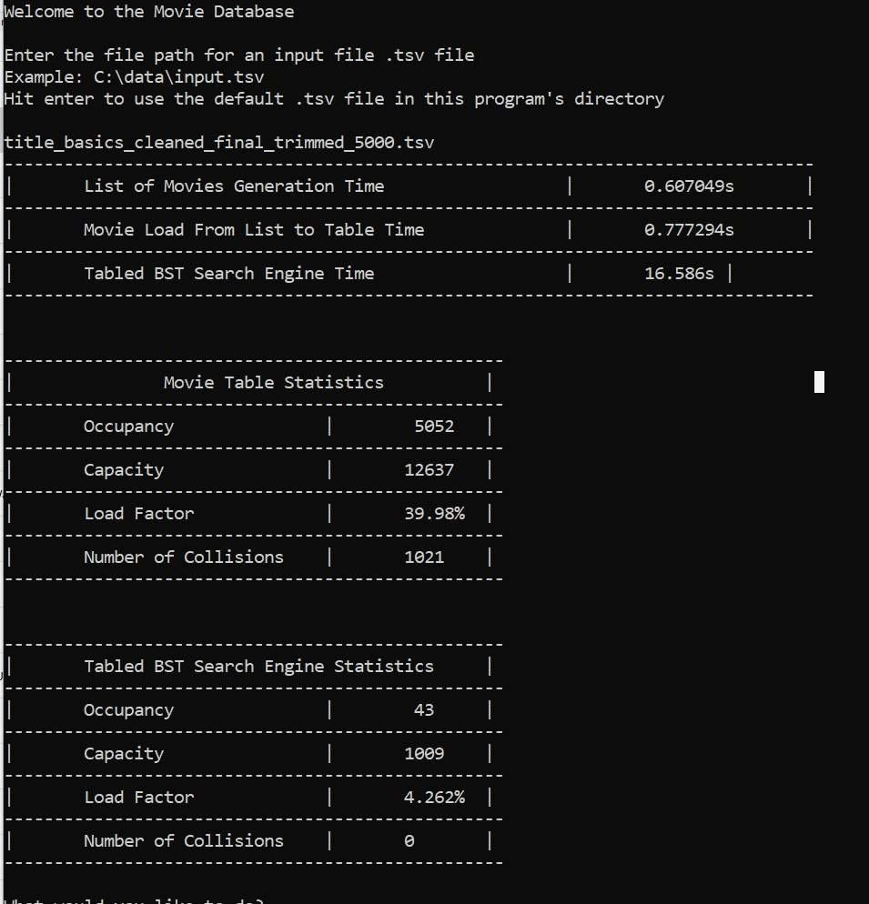
Performance

Slide 7
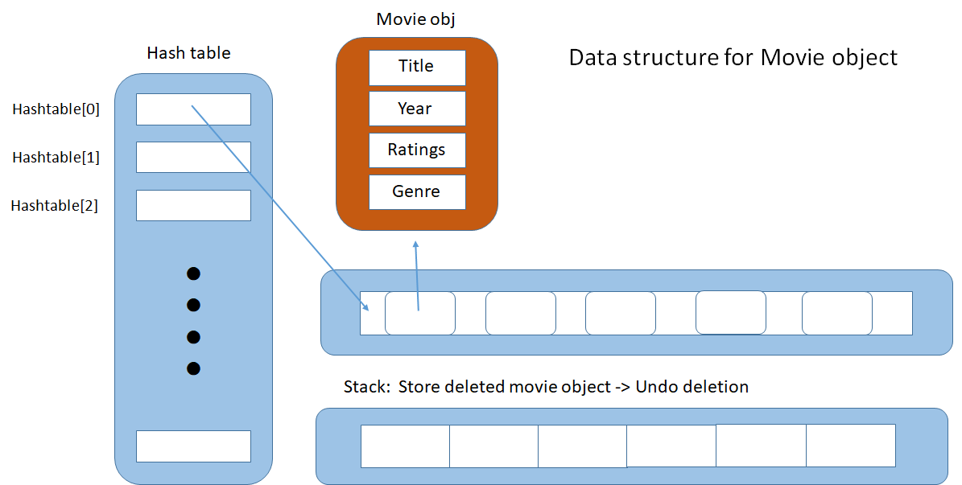
Structure diagram

Slide 8
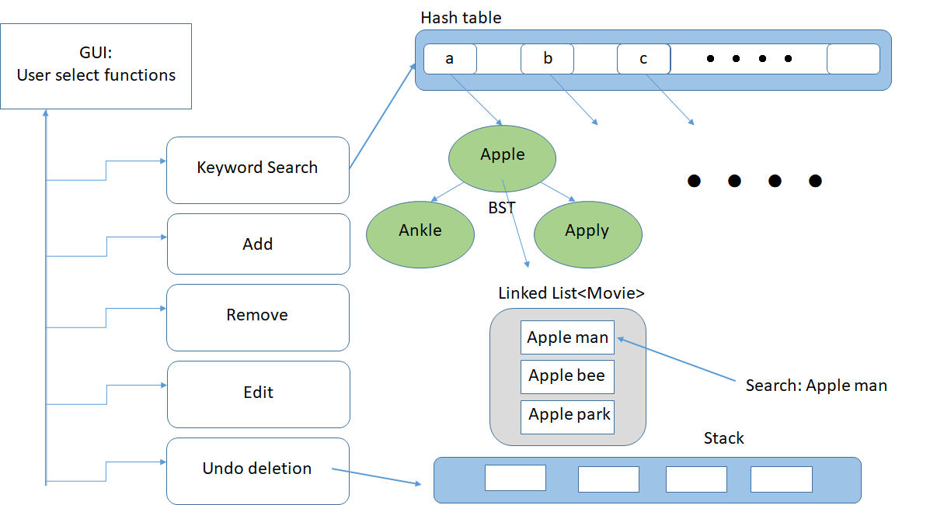
Structure chart

Slide 9
Database Wrapper
HashTable<BinarySearchTree<string, Movie>*>*__searchEngineBST
HashTable<Movie>*>*__movieDB
Stack<Movie>*>*__deletedMovies
Notes:
Design efficiency: having a pointer to a list

Slide 10
Binary Search Tree
template <typename K, typename V> class BinaryNode { private: K __key; List<V>* __values; BinaryNode* __leftChild; BinaryNode* __rightChild;
Notes:
Design efficiency: having a pointer to a list

Slide 11
Binary Search Tree
Adding a new tree
__searchEngineBST->add(std::string(1, keywords->getEntry(j)[0]), new BinarySearchTree<std::string,Movie*>(keywords->getEntry(j)));
Updating the engine
(*__searchEngineBST)[firstCharOfKeyword]->addValue(keyword, edittedMovie);

Slide 12
Hash Table
Open addressing
Quadratic probing for collision resolution
h = (h << 4) + *sp; if (g = h & 0xF0000000) { h ^= g >> 24; h &= ~g; } hashID = (hashID + size_t(0.5 * i) + size_t(0.25 * i * i)) % __capacity;

Slide 13
Hash Table
Updating an attribute
std::string processedKey = processSearchEntry(key); Movie newMovie = __updateSearchEngineBST( newYearReleased, (*__movieDB)[processedKey], 2); (*__movieDB)[processedKey] = new Movie(newMovie);

Slide 14
Linked List
Deletion handler
std::string keyFound = __searchEngineBST->get(firstCharOfKeyword)->getKey(keyword); List<Movie*>* keywordMovies = __searchEngineBST->get(firstCharOfKeyword)->getValues(keyFound); keywordMovies->removeByValue(movieToDelete);

Slide 15
Demo

Slide 16
Q&A

